Slide 1
Descriptive Statistics
Measurements of location and spread of data
BDSiC – Day 3 A
Agenda:
Mean, mode, median
Variability, variation, range
Accuracy/Bias and Precision/Spread
Data types and their common visualizations: scatterplots, histograms, boxplots/violin plots, bar plots (mosaic plots)
Interpretation of popular plots in genomics

Slide 2
You are considering buying a house in a certain neighbourhood. You find a potential house and, to appeal to perceived snobbiness as you are making your decision, your realtor mentions that the average income in this neighbourhood is $100,000 per year.
You buy the house.
A year later, the same realtor knocks on your door, this time acting as a representative of the neighbourhood taxpayers’ association. He would like you to sign a petition to decrease property taxes because, he says, the residents can’t afford an increase in property taxes since the average family income in the neighbourhood is only $25,000 per year.
How is this possible, if the realtor is telling the truth, and no one in the neighbourhood has moved or changed jobs in the last year?
Notes:
Averages can hide a lot of heterogeneity
They can still be useful:
Ave life expectancy (Canada, 2020): 82
Aven life expectancy (US, 2022): 76.1

Slide 3
The two common descriptions of data:
Location:
Central Tendency
Where is the weight of the data?
Average
2. Spread:
How far apart are the data points? Especially: how far apart are the largest and smallest data points?
Range
You will also see:
Skew – The third standardized moment; positive or negative skew. The shape of the distribution is not symmetric.
Kurtosis – The fourth standardized moment; sort of ‘peakness’ of the distribution (fatness of the tails)

Slide 4
A story about central location of the data
Waiter | $35,000
Cook | $30,000
Dishwasher | $25,000
Customer 1 | $80,000
Customer 2 | $50,000
Customer 3 | $30,000
Customer 4 | $45,000
“Average” is approx. $42,143
Waiter | $35,000
Cook | $30,000
Dishwasher | $25,000
Customer 1 | $80,000
Customer 2 | $50,000
Customer 3 | $30,000
Customer 4 | $45,000
Software or Social Engineer | $1,000,000,000
“Average” is $125,000,037
Notes:
Mean is approx. $42,143

Slide 5
$35,000
$30,000
$25,000
$80,000
$50,000
$30,000
$45,000
$25,000
$30,000
$30,000
$35,000
$45,000
$50,000
$80,000
(Arithmetic) Mean = $\frac{\sum_{1}^{n}{x_{i}}}{n}$
Reorder
data
Median = middle value (odd), mean of middle value (even)
Mode = most frequent value
 | Scenario 1 | Scenario 2
mean | $42 143 | $125,000,037
median | $35,000 | $40,000
mode | $30,000 | $30,000
$35,000
$30,000
$25,000
$80,000
$50,000
$30,000
$45,000
$1,000,000,000
$25,000
$30,000
$30,000
$35,000
$45,000
$50,000
$80,000
$1,000,000,000
Reorder
data
Notes:
Mean = $125,000,037

Slide 6
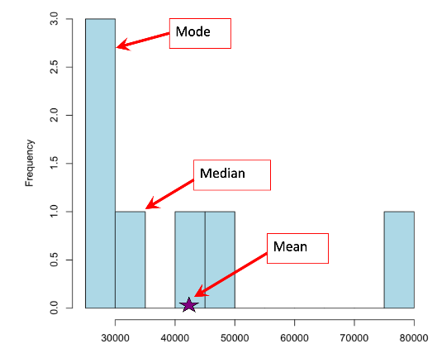
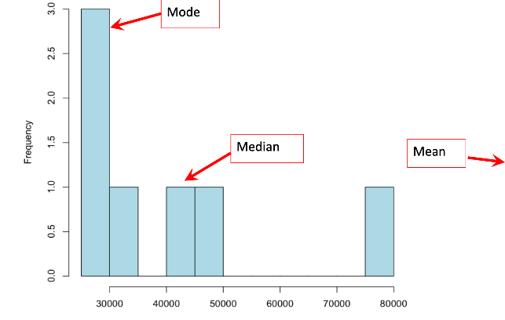
Mean, Mode, and Median can give you different information and they have different benefits
If the data are skewed or have an outlier, median is often a fairer reflection of the data
Median can give quick information abut the data without having to calculate anything
(arithmetic) mean can be a theoretical abstract (2.2 children per woman doesn’t actually exist), but it allows you to use normal distribution to answer questions about the whole population

Slide 7
Will Rogers Phenomenon
“When the Okies left Oklahoma and moved to California, they raised the average intelligence level in both states.”
https://en.wikipedia.org/wiki/Will_Rogers_phenomenon
Actual medical phenomenon: “medical stage migration”
Example: There were more COVID deaths among the vaccinated than the unvaccinated. In September 2022, 12,593 COVID deaths occurred in the United States. Of those, 39% were unvaccinated, while 61% were vaccinated. WHY?
Notes:
Summary statistics are useful (and often necessary), but they can hide a lot of information, and you must interrogate any summary statistics to tease them apart.
(*partially responsible for updated recommendations on mammogram frequency and for the apparent disparity in ‘curing’ prostrate and breast cancer between countries)
* Simpson's paradox occurs when groups of data show one combined, but this trend is reversed when the groups are combined.
It turns out that the relationship between being vaccinated and having a higher percentage of deaths is a fiction created by aggregating data and tossing out relevant information—Simpson’s Paradox.
In the United States, the COVID vaccinated population tends to be older and has more risk factors. This group naturally tends to have worse COVID outcomes. However, when you adjust for age and other risk factors, the CDC finds that COVID vaccinated and boosted individuals have an 18.6 times lower risk of dying from COVID. The vaccines are working!
To wrap up, Simpson’s Paradox occurs when you fail to account for relevant information when analyzing data. This paradox occurs when you aggregate data and lose essential details in the process.

Slide 8
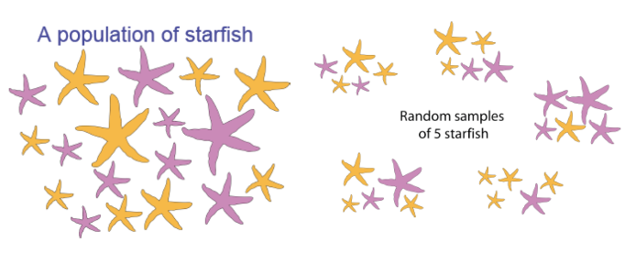
Random Variables:
Characteristics measured on individuals drawn from the population
Value is not constant; it is subject to VARIATION
Categorical (Nominal, Ordinal) or Numeric (Discrete, Continuous)
Notes:
Random Variable
The numerical outcome of a random experiment
Differs between individuals
Population parameters are constants versus estimates which are also random variables which means that they change from one random sample to the next
Categorical or numerical
Ex: Draw a student from the student body
Weight, height, grade point average, SAT score are all numerical random variables
Ex: Toss two dice and allow Y to represent the sum of sum of the dots on the two dice. Y can then be any value between 2 and 12.
Definition of variable: any characteristic or measurement that differs from individual to individual in some ascertainable way. Ie. Length, height, weight, number of teeth, vitamin C content and reproduction type (eggs versus live young) are all examples of variables in Mammals. Warm-bloodedness is not since ALL mammals are warm-blooded so that is a trait that doesn’t vary.
A variable is the actual property measured the individual observations
Categorical: sex chromosome genotype (XX, XY, XO, XXY, XYY); primary language spoken; life stage (egg, larva, juvenile, adult)
Further broken down into nominal (no implied order) or ordinal (implied order eg. Days of the week or life stages)
Numerical - discrete (counts) or continuous (weight, core body temperature)

Slide 9
Types of data:
Categorical Variable
AKA Class variables or Nominal variables
They do not have magnitude on a numerical scale
Nominal
Lack inherent order
Ordinal
Inherent order i.e. age (0-18, 19-30, 30-45, etc)
Ex: blood type, genotype, sex, state, survival (live or die), drug treatment (aspirin vs ibuprofen)
Quantitative Variables
AKA Numerical variables
Random Variable is a Quantitative variable
Continuous
Ability to take any value ex.. Human weight, age
They can be measured
Discrete
Spaces between possible values ex. Number of offspring, age
They can be counted
Notes:
If impose categories on continuous traits they can sometimes become discrete (age)
How you are able to analyze and visualize your data is determined by what type of data you have.

Slide 10
A research team is studying the health and fitness habits of a group of individuals. They collect the following data for each participant:
Resting heart rate (beats per minute)
Favorite type of exercise (running, swimming, cycling, pilates, etc.)
Number of hours exercised per week
Body Mass Index (BMI)
Member status at a gym (yes or no)
Which of the following (A, B, C, or D) correct classifies these variables:
A. Resting heart rate: Nominal
Favorite exercise: Ordinal
Number of hours of exercise per week: Discrete
BMI: Continuous
Membership status: Nominal
B. Resting heart rate: Continuous
Favorite exercise: Nominal
Number of hours of exercise per week: Continuous
BMI: Continuous
Membership status: Categorical
C. Resting heart rate: Ordinal
Favorite exercise: Nominal
Number of hours of exercise per week: Continuous
BMI: Ordinal
Membership status: Nominal
D. Resting heart rate: Discrete
Favorite exercise: Continuous
Number of hours of exercise per week: Discrete
BMI: Continuous
Membership status: Ordinal

Slide 11
Populations
have
PARAMETERS
Represented by Greek Letters
µ; σ
Samples
have
ESTIMATES
Represented by Roman Letters
$\overline{x}$ ; s
Notes:
The philosophy that governs frequentist statistics is: there is some (possibly unknowable) TRUE and CONSTANT parameter value of our measurement out there, and if we take samples in an appropriate way, we will converge onto this value. However, estimates will always be the victims of viccissitude since they will be dependent on the sample that we take them from. Ie. If we are measuring height, and accidentally sample a basketball team, our estimate of average height will be far removed from the TRUE value.

Slide 12
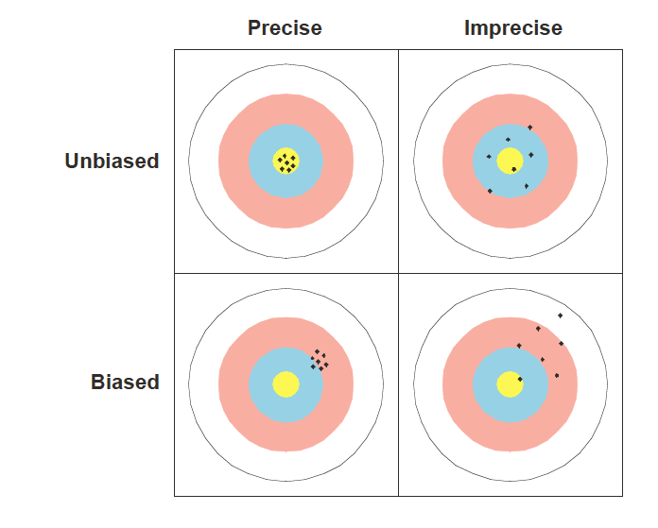
What Makes a ’good’ sample?
Two major considerations:
Accuracy/biased
Bias:
a systematic discrepancy between estimates and the true population characteristic
Precision/Spread
Low Sampling Error, high precision
To address these, you typically need:
A sufficiently large sample
Randomly Sampled data points that are independent of each other
Notes:
Sufficiently large
Larger samples have a smaller sampling error
Sampling error: If we take a sample from a population, unless we measure every member of that population the sample will not exactly have the same properties as the population. This deviation of the sample statistic from the parameter is called the sampling error
Sampling error can be thought of as the repeatability of the sample
Sampling error and precision are inversely proportional! SO larger samples are more precise since they have lower sampling error.
Imagine that a sample of the same size as the real was hypothetically taken from the same population an infinite number of times. Each of these imaginary samples would give a different estimate of the parameter in question. The standard deviation of these pseudo-estimates is what is called the standard error of the estimate.In reality of course we cannot get an infinite number of samples: we only have one, in fact. So we will use our understanding of probability to predict the standard error of any given sample, based on the properties of that sample.
A very basic concept in probability and statistics is that a smaller sample will on average have more sampling error than a larger sample.It is easy to see why this is if it is taken to an extreme. A sample of only one individual is obviously different from the population, in the sense that every individual is different from the mean in some respects. Thus a very small sample will usually deviate substantially from the population. In contrast, if we take a very, very large sample, the sample will almost re-create the population, and the sample statistic is unlikely to vary much from the parametric value. This difference between a sample of size one and a huge sample holds true for less extreme cases as well.
I cut and paste this from a website which brings in an important related point:
The size of the sample is another important consideration. If you flipped a coin 5 times and it came up "heads" 4 times, would you be correct to say that the coin will land on heads 80% of the time? It did for your sample of 5 flips. But what would happen if you flipped the coin 100 times or 1000 times. Would heads still come up 80% of the time? The number of people or number of trials in an experiment that are needed to give you an accurate estimate of the population is dependent on several variables. One important consideration is how much variability there is in the response. If a response has a high degree of variability, then a larger sample will be needed. In general, the larger the sample size, the better the estimation.
2. Randomly sampled
Equal chance of selection
unbiased
Independent
The selection of one unit does not influence the selection of any other unit
Sample size is smaller than we think if the individuals measured are not independent

Slide 13
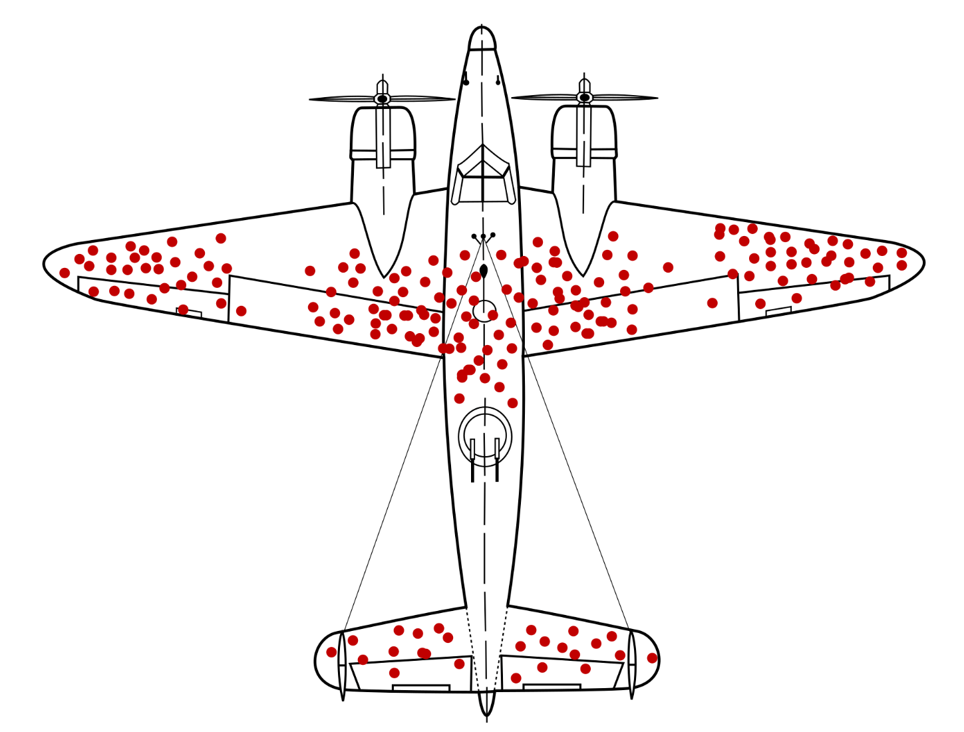
Notes:
Survivorship bias

Slide 14
Question: Which of the following statements best describes the difference between accuracy and precision?
Accuracy refers to how close measurements are to each other, while precision refers to how close measurements are to the true value.
Accuracy refers to how close measurements are to the true value, while precision refers to how consistent measurements are with each other.
Accuracy and precision are the same and both refer to how close measurements are to the true value.
Accuracy and precision are unrelated to measurements and focus only on data variability.
Notes:
Accuracy refers to how close measurements are to the true value, while precision refers to how consistent measurements are with each other.

Slide 15
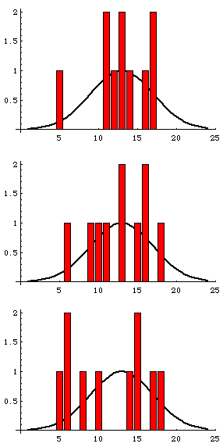
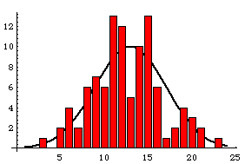
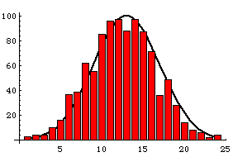
N=1000
N=100
n(individual sample sizes) = 10
N is the number of repeats of sample. THIS value ranges from 10 samples to 1000 samples (each one of size 10).
N=10
Notes:
The actual underlying distribution is the normal distribution (the line) with μ=13 and σ2=16
All you really need to take away from this slide is that when you sample more individuals, you get closer to the underlying truth.

Slide 16
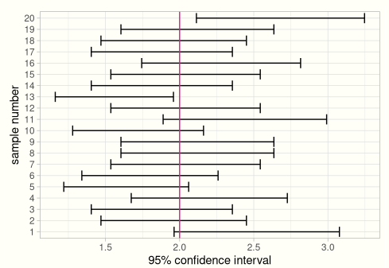
95% Confidence Intervals
95% Confidence Interval is calculated:
$\overline{x}−1.96∗{SE}_{\overline{x}}$ <$μ$< $\overline{x}+1.96∗{SE}_{\overline{x}}$
We care a lot about precision and sample sizes because (along with alpha and some other assumptions) that is
going to create our confidence intervals!
https://www.zoology.ubc.ca/~whitlock/Kingfisher/CIMean.htm
https://stats103.com/confidence-intervals/
https://onlinestatbook.com/2/estimation/ci_sim.html
Notes:
The online simulations don’t work anymore, but there are still useful pieces!
How do we talk about this confidence interval? There is a 95% chance that the 95% confidence interval contains the population value/parameter

Slide 17
A. Can the Standard deviation ever be zero? If so, when would that situation occur?
B. Imagine that we have a population that is skewed to the left. This population has a mean of 112 and a standard deviation of 16. Using a simulation program, Tyler simulated drawing 1000 samples of size 2 from the population. He then plotted the means for each of the samples that he drew. Alex simulated drawing 1000 samples of size 30, and he also plotted the means for each of the samples that he drew.
Good simulator here: https://www.zoology.ubc.ca/~whitlock/Kingfisher/CIMean.htm
Would you expect the shape of Tyler’ s distribution of sample means to differ from the shape of Alex’s distribution of sample means? Please explain your answer (i.e., If you do expect the shapes to differ, how will they differ? If you do not expect the shapes to differ, why not?)
Is the mean of Tyler’s distribution of sample means <,>, or = to the mean of Alex’s distribution of sample means and to the mean of the sample?
How would you rank, from largest to smallest, the following: the standard deviation of Tyler’s distribution of sample means, the standard deviation of Alex’s distribution of sample means, and the standard deviation of the sample itself?
Notes:
You can use the whitlock and Schluter simulation to develop an intuition about this.

Slide 18
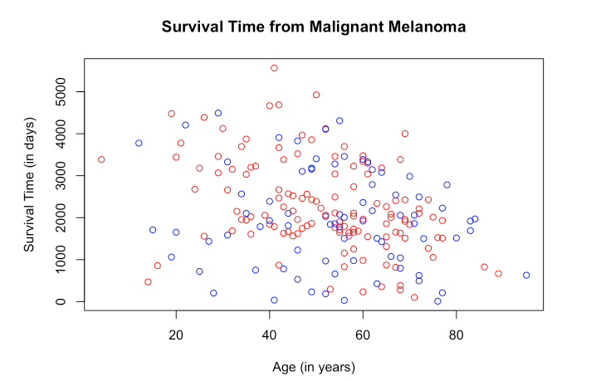
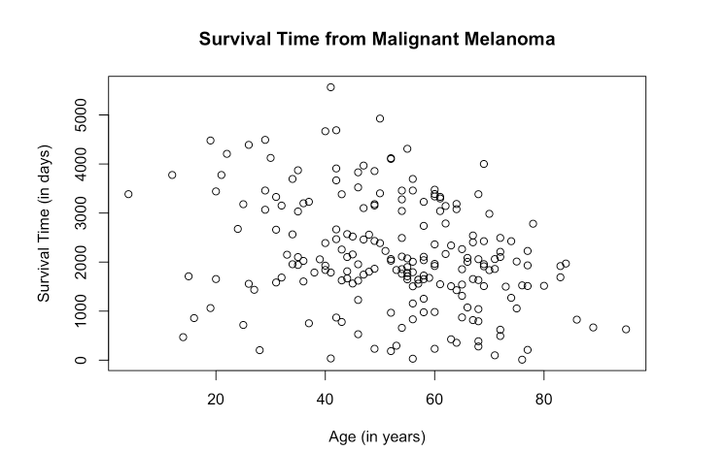
Scatterplot
Free online textbook that gives r code!
https://bookdown.org/dli/rguide/scatterplots-and-best-fit-lines-two-sets.html
Hans Rosling ted talk (his website has data visualizations – scatterplots that move!- and datasets):
https://www.ted.com/talks/hans_rosling_the_best_stats_you_ve_ever_seen

Slide 19
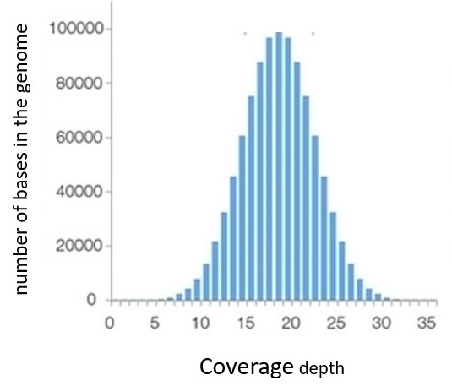
Histogram
Coverage plot of complete genome
One warning about histograms:
Be careful about “bin” size; you can introduce artefacts!
https://www.biostars.org/p/9487269/

Slide 20
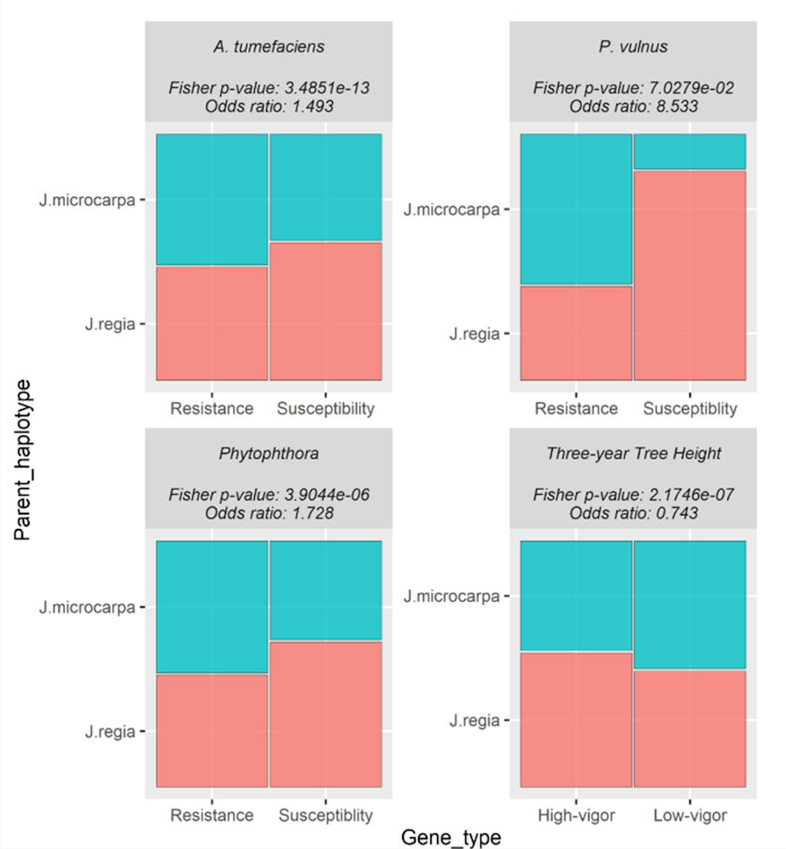
Mosaic Plot
https://www.mdpi.com/1422-0067/25/2/931
Mosaic plot representing proportions of differentially expressed genes (DEGs) from each trait colored by the haplotype the genes mapped to. Each plot is labeled with the pathogen, Fisher's exact p-value, and Fisher's exact odds ratio. The odds ratio represents the ratio of the odds of the J. regia haplotype expressing a gene positively correlated to the trait compared to the odds of the J. microcarpa haplotype expressing a gene negatively correlated to the trait.

Slide 21
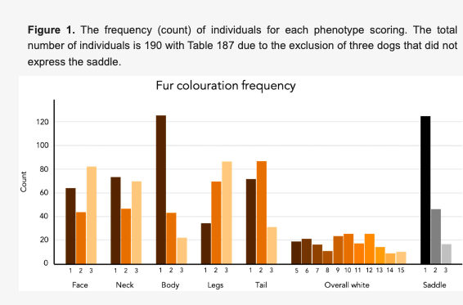
Bar Plot
https://www.mdpi.com/2073-4425/12/2/316
The frequency (count) of individuals for each phenotype scoring. The total number of individuals is 190 with Table 187 due to the exclusion of three dogs that did not express the saddle

Slide 22
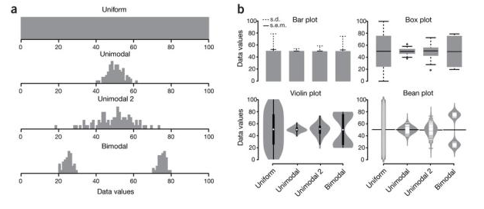
Boxplots & Violin plots
Data visualization with box plots(a)
Hypothetical sample data sets of 100 data points each that are uniform, unimodal with one of two different variances or bimodal. Simple bar plot representations and statistical parameters may obscure such different data distributions.
(b) Comparison of data visualization methods. Bar plots typically represent only the mean and s.d. or s.e.m. Box plots visualize the five-number summary of a data set (minimum, lower quartile, median, upper quartile and maximum). Violin and bean plots represent the actual distribution of the individual data sets.
https://pubmed.ncbi.nlm.nih.gov/24481215/

Slide 23
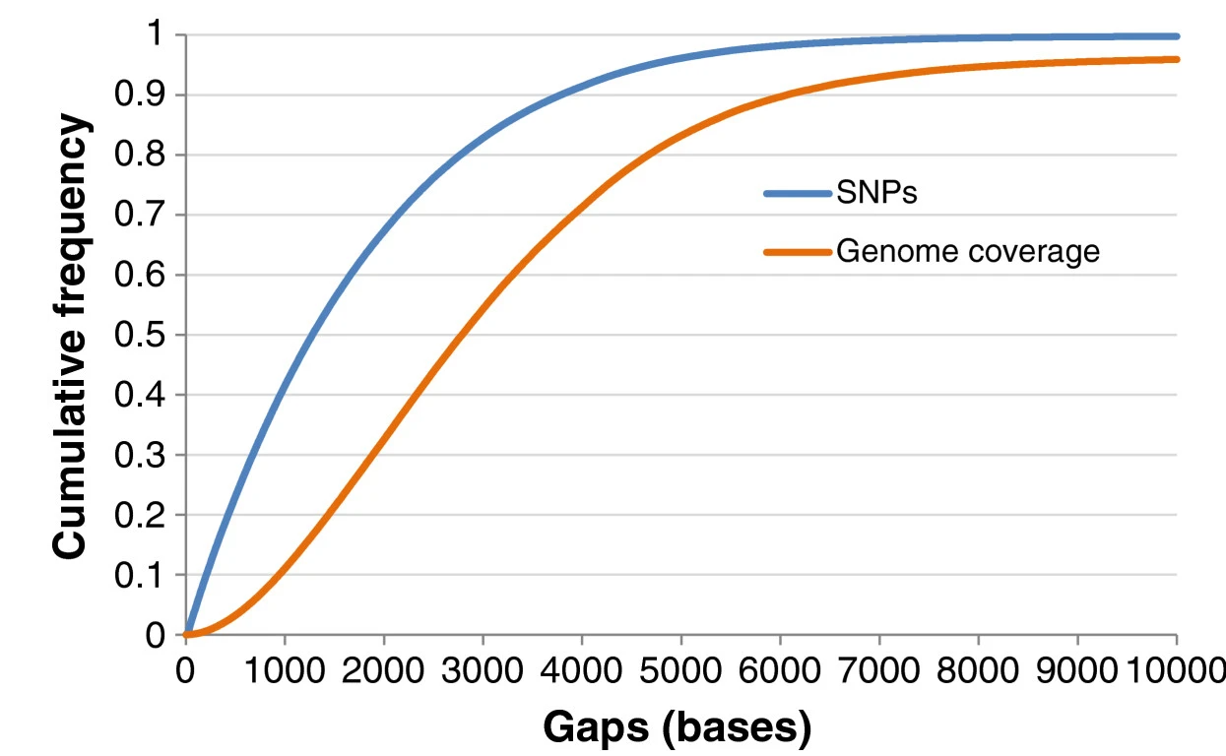
Cumulative Frequency Distribution
https://bmcgenomics.biomedcentral.com/articles/10.1186/1471-2164-14-59
Cumulative frequency distributions of SNPs and genome coverage as functions of inter-marker spacing in the panel. Inter-marker spacing included distances between consecutive SNPs and the distances from chromosome ends to the nearest SNP in 600 K panel.

Slide 24
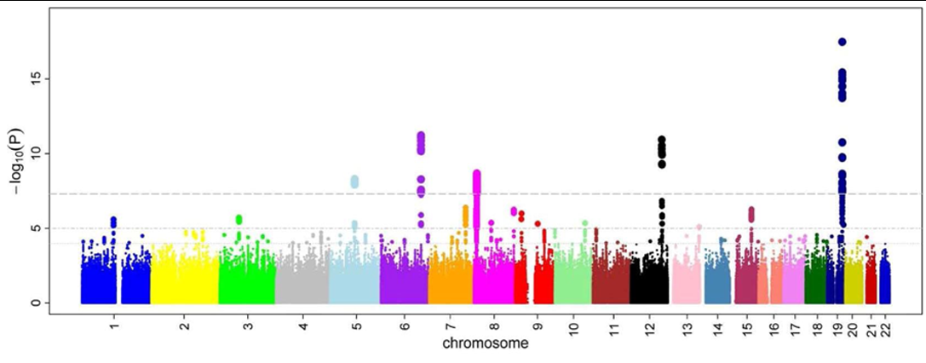
https://en.wikipedia.org/wiki/Manhattan_plot
Notes:
In GWAS Manhattan plots, genomic coordinates are displayed along the x-axis, with the negative logarithm of the association p-value for each single nucleotide polymorphism (SNP) displayed on the y-axis, meaning that each dot on the Manhattan plot signifies an SNP. Because the strongest associations have the smallest p-values (e.g., 10⁻¹⁵), their negative logarithms will be the greatest (e.g., 15). The different colors of each block usually show the extent of each chromosome.

